Slide 1
Automatic Transfer Switches
Presented
By
Oscar Gross
Kohler Power Systems
Notes:
Take you through a journey of how to select a specific ATS based on all availabale configurations and in the processs explain what an ATS is, how it operates…

Slide 2

Need to keep the lights ON if utility power goes out
It’s your first day at OG Engineers, Inc. You have been assigned to design and specify the on site emergency power system for a new facility in the area.

Slide 3

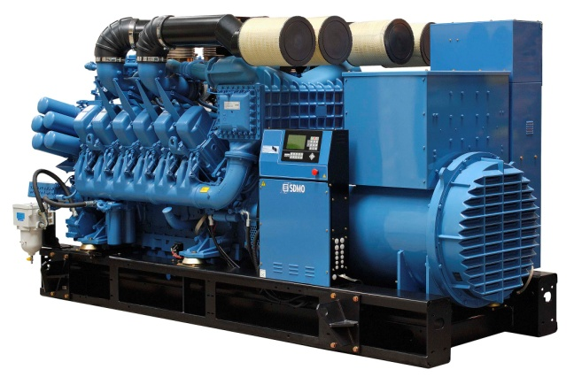
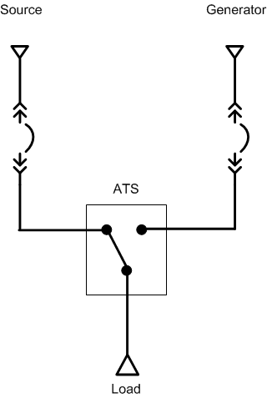
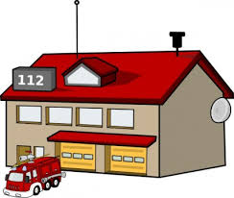
How do we get power from genset to load?

Slide 4
Automatic Transfer Switch (ATS)
A UL1008 listed device that automatically transfers the load from a primary (normal) power source (utility) to a secondary (emergency) source (generator)
Has three (3) connection points
  Normal
  Emergency
  Load
Manages
  Loss / Return of normal sensing
  Time delays
  Genset start and stop

Slide 5
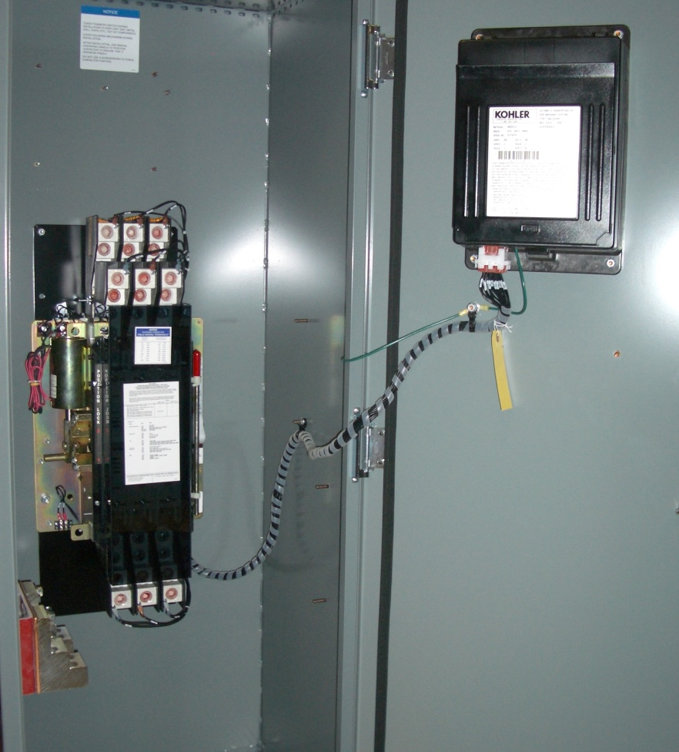
What the three dots in the box look like
Contactor
Controller
Notes:
Contactor - Three connection points (Normal, Emergency, Load)
Controller – Manages Loss/Return of Normal, time delays and start/stop of generator

Slide 6
How to Specify an ATS
Operation
Single Line
Controls
Enclosure
Amp Rating
Withstand Rating
Frame Type
Neutral Switching
Transfer Type
Pre/Post signals
Load Add/Shed
Metering
Monitoring
Test
Nema 1
Nema 12
Nema 3R
Nema 4
Nema 4X
Notes:
The single lie is the map and the specification defines the operation (direction) and the requirements (rules) we must follow…. After we determine both of these things, only then can we select the controls and define how to package the controls

Slide 7
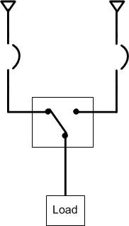
Amp Rating
What is the load?
  Need to protect ATS
    Need to protect with circuit breakers
1200A
1200A
1200A

Slide 8
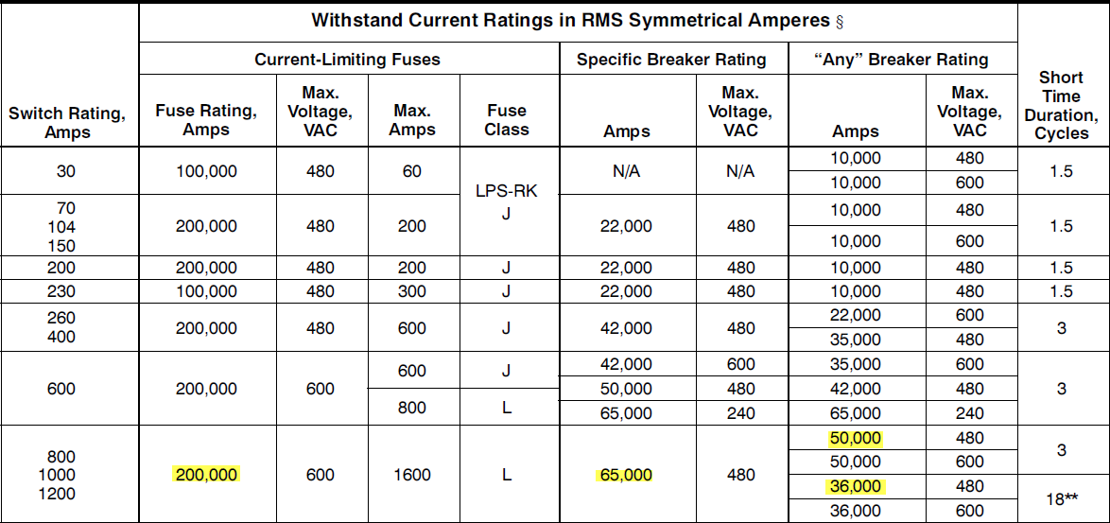
Withstand Rating

Slide 9
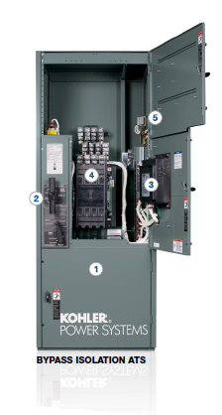
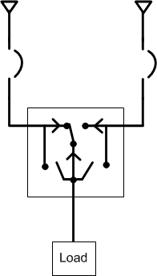
Frame Type - Bypass Isolation
Allows for continuity of power during maintenance of the contactor
  Two TS mechanisms in parallel
    Automatic - Drawout
    Manual - Fixed
      Allows for servicing
      the draw-out contactor

Slide 10
Frame Type - Service Entrance Rated
Breaker Based
Contactor Based
  External Breaker
  Integrated Breaker
Notes:
Service entrance automatic transfer switches incorporate an isolating mechanism and over-current protection on the utility supply
Potential Cost Savings
Potential footprint reduction

Slide 11
ATS – 3 Pole or 4 Pole (Ground Fault)
Number of Poles
  3 Pole
    Solid Neutral – Generator is NOT a separately derived source
      Breaker trip units on the generator can NOT detect a ground fault
  4 Pole
    Generator is a separately derived source
      Breaker trip units on a generator can detect a ground fault

Slide 12
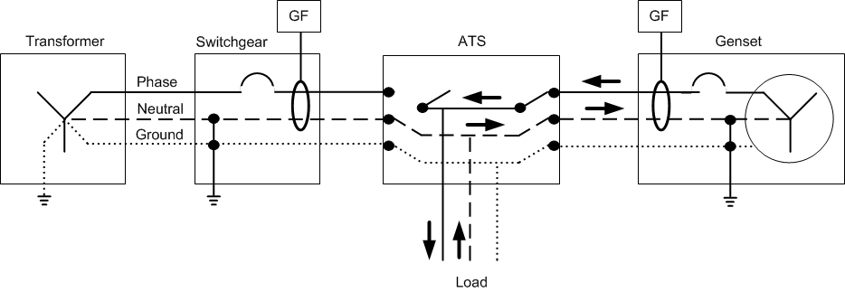
3 - Pole
Genset is NOT a separately derived source
Notes:
To simplify the drawings, we are only showing one of the three phases.
Electricity generated leaves the generator and will need to come back to the neutral of the source
Everything gen produces will come back.

Slide 13
3 - Pole
Genset is NOT a separately derived source
Transformer
Switchgear
3 Pole ATS
Generator
Phase
Neutral
Ground
Load
Notes:
To simplify the drawings, we are only showing one of the three phases.
Electricity generated leaves the generator and will need to come back to the neutral of the source
Everything gen produces will come back.
You should NEVER bond the neutral to the ground on the emergency source when the Genset is NOT a separately derived source.

Slide 14
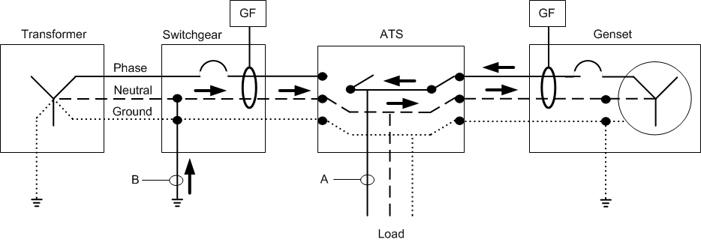
3 - Pole
Genset is NOT a separately derived source
Notes:
Point A has a ground fault to one of the phases.
Power comes back through point B. (Grounded neutral) and flows back to the gen through the neutral. The algebraic sum of the three phases will still sum up to the current on the neutral. Ground fault is undetected. Sensing CT sees that the current from all phases matches what is returning back to neutral.

Slide 15
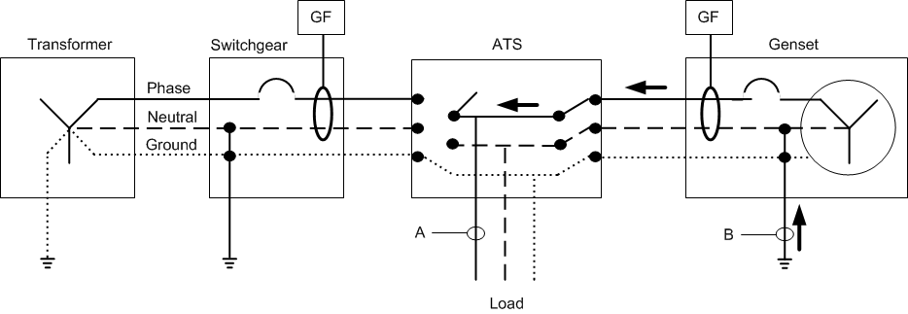
4 - Pole
Genset is a separately derived source
GFP is required on the emergency source
Notes:
Multiple reasons to select a 4 pole ATS
Generator is a separately derived source
Ground Fault Protection for the emergency source is required

Slide 16
Review

Slide 17
How to Specify an ATS
Operation
Single Line
Controls
Enclosure
Amp Rating
Withstand Rating
Frame Type
Neutral Switching
Transfer Type
Pre/Post signals
Add / Shed
Metering
Monitoring
Test
Nema 1
Nema 12
Nema 3R
Nema 4
Nema 4X

Slide 18
Transfer Type - Open
Break before make
  Power will momentarily be interrupted during live/live power transfers
  Very fast – Hard for human eye to detect

Slide 19
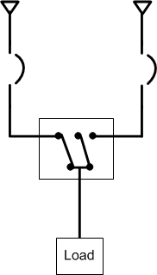
Transfer Type - Closed
Make before break
  Under 100ms (6 Cycles)
  May increase short circuit current contribution (gen + utility)
  Some utilities require additional protective relays
  Passive synchronization
    In phase monitor
    May need to run genset slightly fast

Slide 20

Transfer Type – Programmed Transition
Also know as delayed transition
Has center off position
  Load shed to center off
  Lets motor and high inertia loads stop
Not recommenced for “10 Sec.” loads

Slide 21
How to Specify an ATS
Operation
Single Line
Controls
Enclosure
Amp Rating
Withstand Rating
Frame Type
Neutral Switching
Transfer Type
Pre/Post signals
Load Add/Shed
Metering
Monitoring
Test
Nema 1
Nema 12
Nema 3R
Nema 4
Nema 4X

Slide 22
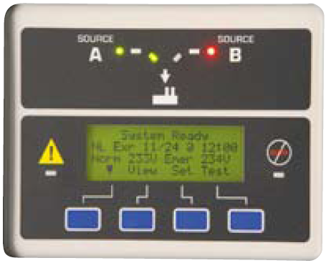
Interface to the system

Slide 23
ATS Controller
Setup and monitoring
  Time delays
    Engine start
    Utility stable
  Metering
    Normal source
    Emergency source
  Testing (Calendar Based Test)
    Test with Load
    Test with NO Load
  Remote control and monitoring
    Hard wired
    Modbus
  Load Control
    Load Shed/Load Add

Slide 24
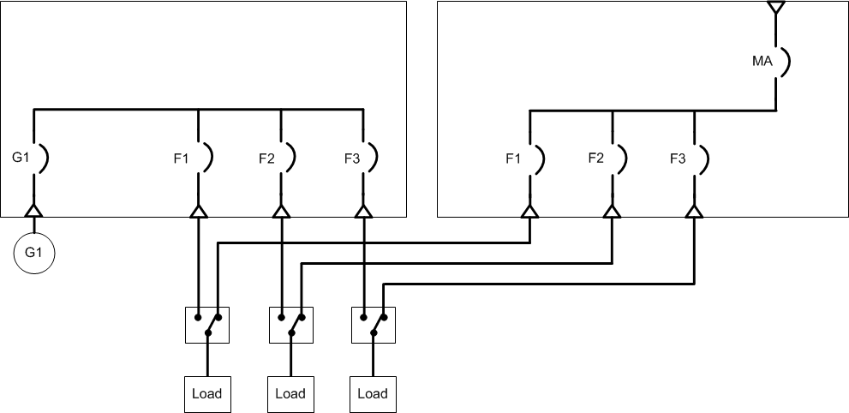
What if there is more than one ATS?
Notes:
Allows the ability to load shed based on load priority

Slide 25
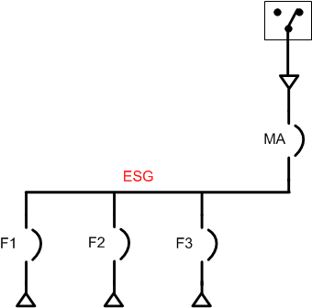
ATS can load shed connected loads
Notes:
Current metering package

Slide 26
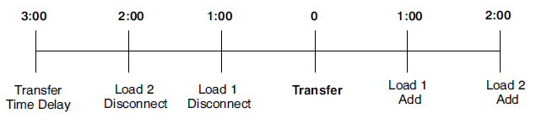
Pre / Post Transfer Signals
Time Based load control: Pre/Post transfer signals based on timer
Current based load control: Adds/Removes loads based on current measurement

Slide 27
How to Specify an ATS
Operation
Single Line
Controls
Enclosure
Amp Rating
Withstand Rating
Frame Type
Neutral Switching
Transfer Type
Pre/Post signals
Load Add / Shed
Metering
Monitoring
Test
Nema 1
Nema 12
Nema 3R
Nema 4
Nema 4X

Slide 28
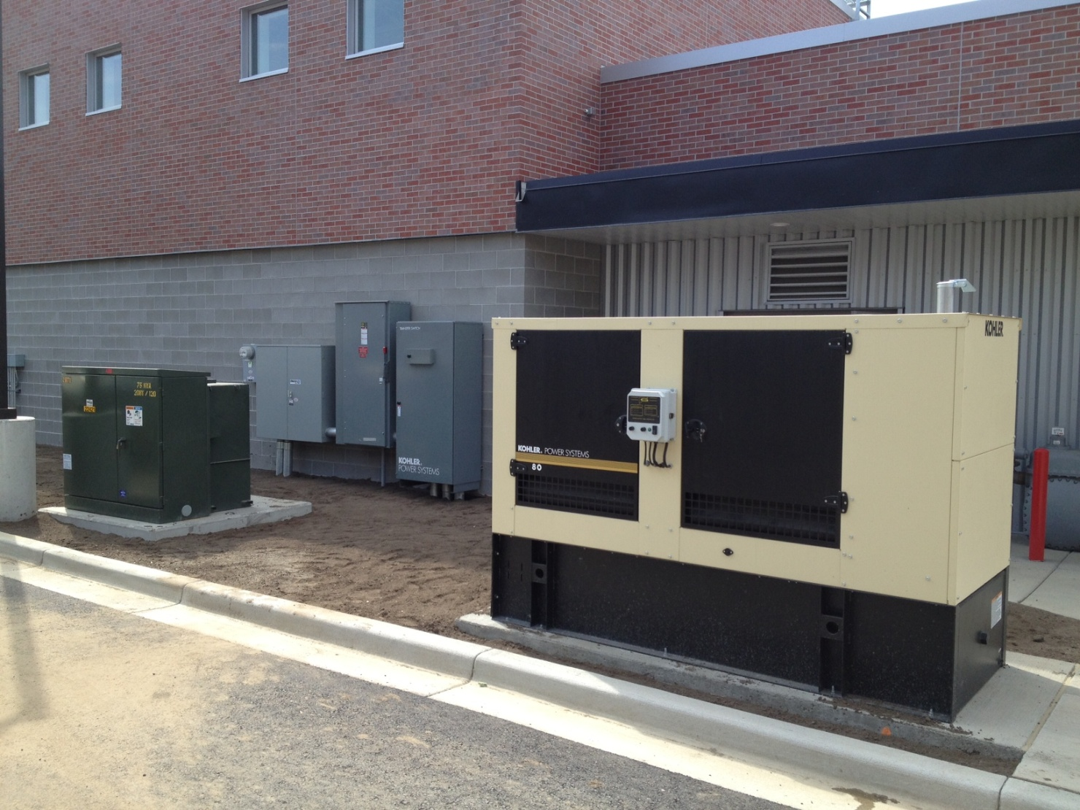
Typical installation

Slide 29
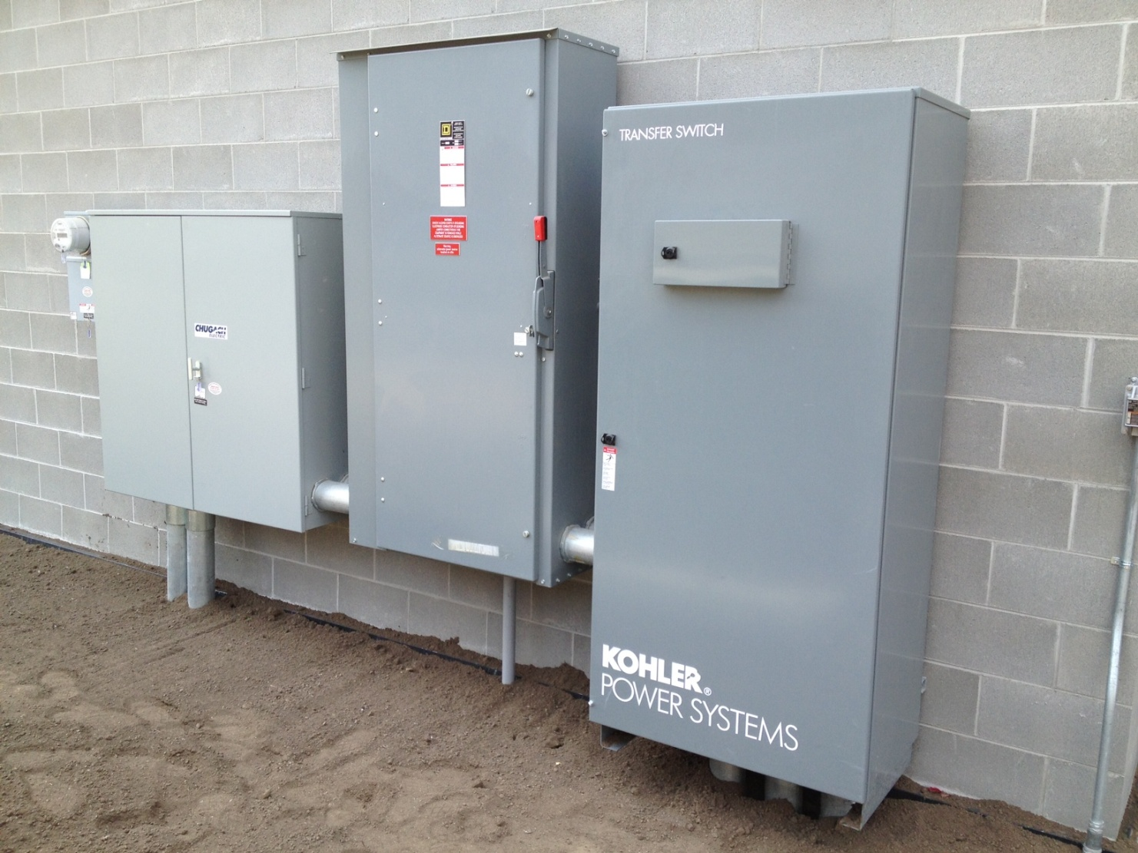
Typical Installation

Slide 30
THANK YOU!!!
Oscar Gross
Manager-Engineered Solutions
KOHLER POWER SYSTEMS
Office: Atlanta, GA
Mobile: 920-226-9751
Oscar.Gross@KOHLER.com

